Slide 1
Knowledge management in an age of disruption
David Pender
For every great problem
there is a simple solution –
and it’s wrong.
Oscar Wilde

Slide 2
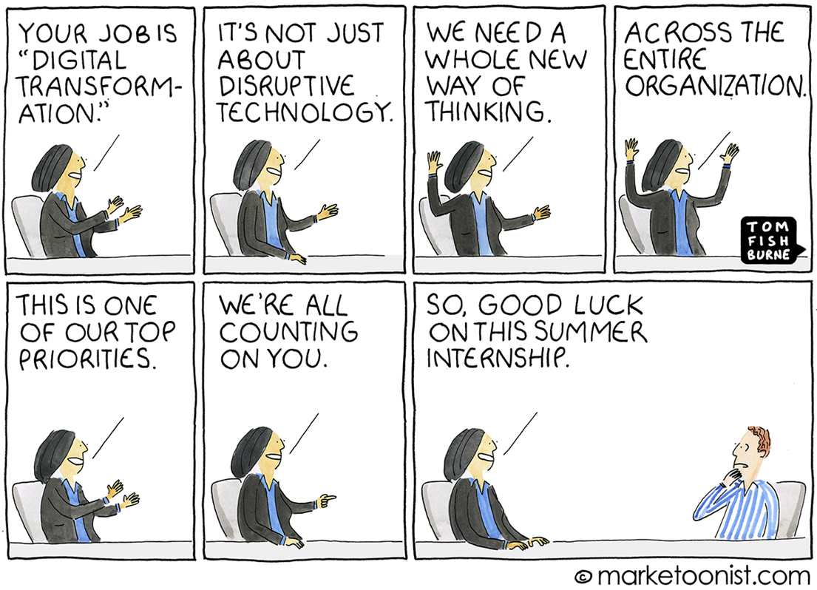

Slide 3
Knowledge management in an age of disruption
Agenda
For context, a very brief look at Industry 4.0
Defining the problem
A knowledge management approach to solution
Together or alone?

Slide 4
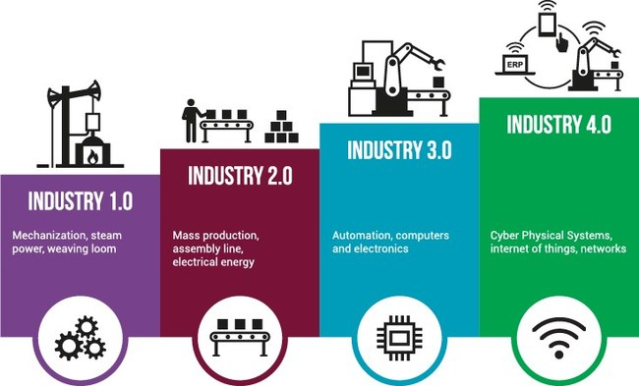
Industry 4.0
A very brief look

Slide 5
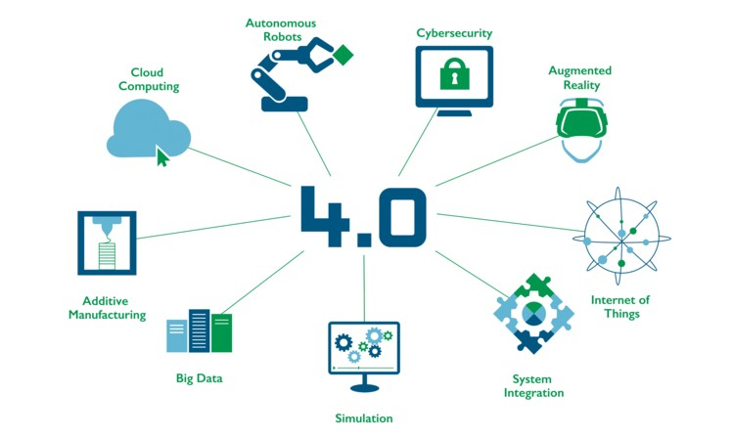
Industry 4.0

Slide 6
The problem

Slide 7
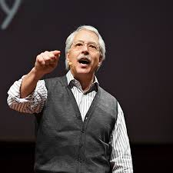
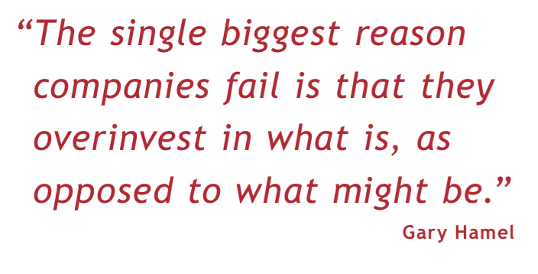

Slide 8
Mental Models
Present
Past
Future

Slide 9
The real issue(s)
Lack of clarity
- uncertainty
Technology
changes
Unlearning &
learning
Time
horizons

Slide 10
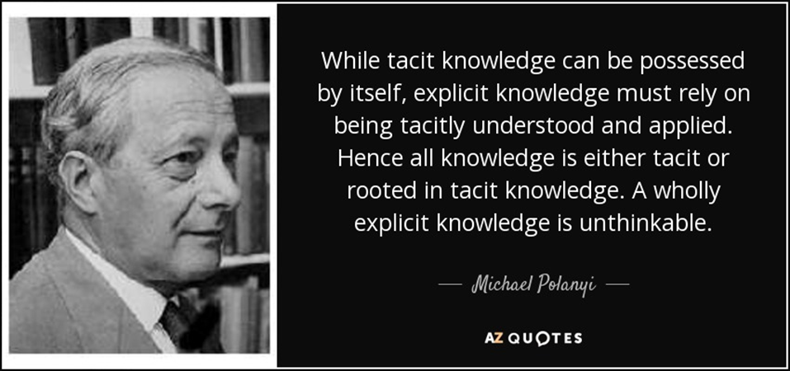

Slide 11
The real issue(s)
Unlearning & inertia
Discard old ‘routines’
Difficulties when ‘routine’ is
socially or culturally embedded
Organisational v individual
unlearning
Inertia
The inability for organisations to
change as rapidly as their
environment
Past learning embedded
‘Poison’ to new ideas

Slide 12
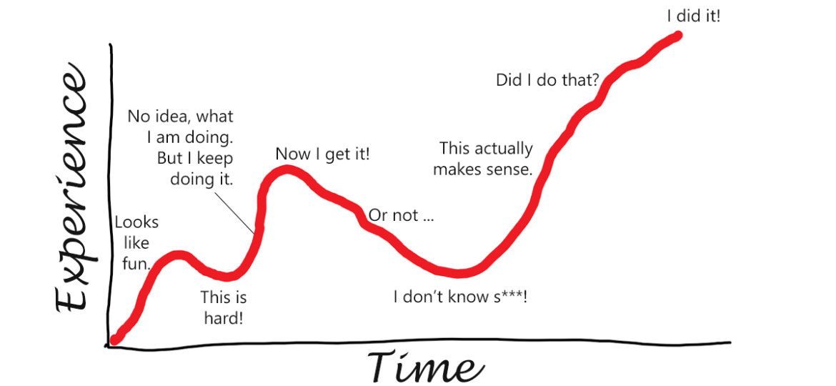
The time issue

Slide 13
The ‘delay’ problem
Knowledge
Competitive
problem
Market
needs
Keeping up
Start late
Time

Slide 14
A knowledge management approach to solution

Slide 15
In knowledge terms …
Future
Scenarios
A
B
What your company MUST DO
What your company MUST KNOW
C
E
D
Strategy gap
Strategy K gap
What your company CAN DO
What your company KNOWS
Now

Slide 16
Embedding the ‘smarts’
Cannot be ‘outsourced’
Active
Guided experiences
Practice
Simulation
Observation
Problem solving
Experimentation
Socratic methods
Stories
Classrooms
Presentations
Knowledge framing:
Build receptors
Knowledge filtering:
Network effect
Knowledge building:
Experience & expertise
Knowledge acquisition:
Guided experiences
Self
Others
Passive

Slide 17
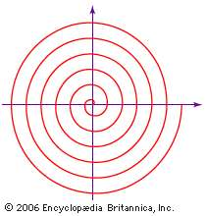
How?
Knowing ‘across’
Socialise
Externalise
Combine
Internalise
Knowing ‘in’
Knowing ‘forward’

Slide 18
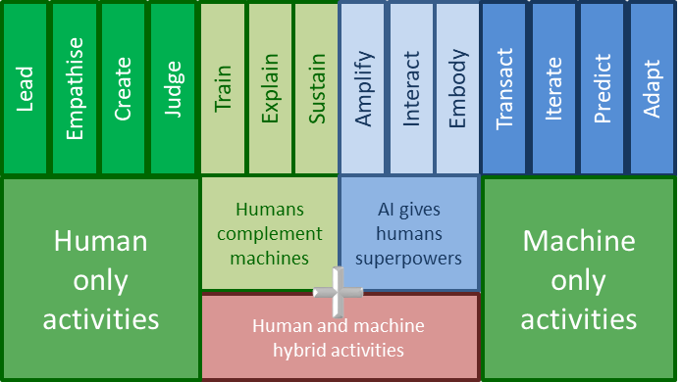
An example to stimulate thinking
Think about humans and AI …

Slide 19
Alone or community?

Slide 20
Communities
Capacity
Focuses on making internal connections
Applies learning across possibilities
Competence
Concentrates on building competence
Develops “best” practice
Interest
People with a common interest
Often voluntary
Capability
Focuses on extending external links
“Best” practice become common practice

Slide 21
Results
Competence,
capability & capacity
Peer
Assist
Experiments
Shared
Learning
Process
Rigorous process
minimises
knowledge
acquisition risk
Communities of
interest
Learn from outside

Slide 22
Data, information, knowledge & wisdom
Joining
of wholes
Wisdom
People and processes
are the bridge creating
knowledge from
information
Formation of
a whole
Knowledge
Future
Novelty
Context
Information
Connection
of parts
Data
Past
Gathering
of parts
Experience
Understanding
Researching
Absorbing
Doing
Interacting
Reflecting

Slide 23
At each iteration …
Known knowns
Unknown knowns
Known unknowns
Unknown Unknowns
What has to be TRUE for my
assumptions
to hold?
Examine & reflect

Slide 24
Two starting points

Slide 25
Knowledge management in an age of disruption
Agenda
For context, a very brief look at Industry 4.0
Defining the problem
A knowledge management approach to solution
Together or alone?

Slide 26
Concluding thought

Slide 27
Questions

