Slide 1
Laboratory Animal Services 2012 Induction and Orientation Program
Presenters:
Andrew Bartlett (Manager)
Roxanne Collingwood (Waite Facilities Coordinator)
Pacita Wissell (MSAH Facility Coordinator)
Robyn Hay (Roseworthy Senior Animal Technician)
Tiffany Boehm (Health, Safety and Compliance Officer)
Faye Gardner (Office Manager)
Denise Noonan (Animal Welfare Officer)
2.00pm Wednesday 22 February 2012
Medical School North, Level 2 Seminar Room
Notes:
Welcome
Programme’s purpose
insight to animal facility operations
the bigger picture (your role; our role; ethics and welfare)
reduce mistakes due to ignorance (experimental integrity)
the MSAH is a complex facility made up of many bio- exclusion/containment areas which makes adherence to the policies vital
Introduction to LAS management team and their respective roles
Faye Gardner
Roxanne Collingwood
Pacita Wissell
Denise Noonan

Slide 2
Programme’s Structure
Vision and Values
Policy Framework/Partnership
LAS organisational structure
Animal Welfare and Ethical Conduct
Animal Welfare Officer
Administrative procedures/policies
Office Manager
Standard Operating Procedures (SOPs)
Facility Coordinators
Health, Safety and Compliance
Question time
Notes:
Outline of presentation content
Who is LAS?
What does LAS do?
Where is LAS?
How do I see the investigator service provider relationship working!
How do you interact with LAS staff and facilities?

Slide 3
Vision
Laboratory Animal Services will support the University of Adelaide’s biomedical research community through the delivery of best practice animal husbandry and the provision of world standard laboratory animal products
and services, whilst maintaining a commitment to the principles of the
Australian code of practice for the care and use of animals for scientific purposes.
(7th Edition 2004)
Notes:
LAS is a SERVICE department, our role is to support investigators by maintaining infrastructure (animal houses) at the appropriate standard for its containment classification. We are a Trading Unit effectively run as a business. That does not always sit well in a University culture!
Our ACO principle role is to deliver BEST PRACTICE animal husbandry in accordance with the Code of Practice.
This is not just a feel good statement, it is a benchmark our performance is measured against!

Slide 4
Values/Objectives
Laboratory Animal Services will…
…demonstrate a commitment to the purpose of the Australian code of practice for the care and use of animals for scientific purposes, specifically, “…to ensure the ethical and humane care and use of animals used for scientific purposes”.
…strive for continuous improvement in animal husbandry through the training and development of the animal care officers and investigators.
…develop a customer focus by providing investigators with professional, timely and effective support.
Notes:
Another important role of the ACO is to provide direct support to investigators, that support may come in the form of advice; technical assistance; specific modifications to animal husbandry procedures, etc…
HOWEVER- the ACOs are NOT your personal assistants-you have a responsibility (and are expected) to conduct yourselves professionally and courteously.
Why do we have a Vision and Values?
Because they make us ACCOUNTABLE!! If you feel we are not providing a level of service consistent with the Vision and Values then you should be communicating your concerns to the facility coordinator or ME!
In order to achieve our expected standards effective communication is essential. Constructive feedback from you is encouraged and will be addressed
Our stated objectives/values provide a focus for the staff to continuously improve both technical skills and customer service delivery.

Slide 5
Policy Framework BIOMEDICAL RESEARCH
Research Integrity
+
Animal Welfare
PREVENTION OF CRUELTY TO ANIMALS ACT 1985
AUSTRALIAN CODE OF PRACTICE FOR THE
CARE AND USE OF ANIMALS FOR SCIENTIFIC
PURPOSES - 7TH EDITION 2004
ANIMAL USERS HANDBOOK
Policies
Protocols
ANIMAL ETHICS COMMITTEE
Importation/Export
Transportation
Acquisition
Quarantine
Animal housing standards
Training
Breeding/Weaning (rodents)
Polyclonal antibody production
Anaesthesia
Euthanasia
Contingency plans
SPF rodent production
Animal health surveillance
AEC applications
Security procedures
BIOMEDICAL ANIMAL RESEARCH ADVISORY GROUP
The Client
Traffic flows
Animal husbandry
Technical procedures
Facility maintenance
Housekeeping
Standard Operating Procedures (SOPs)
LABORATORY ANIMAL SERVICES
ANIMAL WELFARE OFFICE
Notes:
The point I’m trying to make in this slide is that the environment in which we operate is a complex one. No one works in isolation. Every activity impacts either directly or indirectly on all of us. Pacita will be discussing the SOPs and policies in more detail but for now understand that the hoops we make you jump through are all about ensuring research integrity and animal welfare are the highest priorities.

Slide 6
The “Partnership”
Animal Carer and the Biomedical Researcher
Priorities AC BmR
Animal Welfare  
Research Integrity  
Customer Service  
Effective Communication  
The complexity of the environment in which we work can distort our perspectives at a given point in time BUT our objectives should always be the same!!
Notes:
I strongly believe in the “partnership” philosophy. Just like any relationship there will be times of stress and strain but if we all acknowledge that we’re on the same side we will be able to work through anything. Please communicate professionally and constructively with the ACOs and they will be an invaluable asset to your research endeavours.

Slide 7
Laboratory Animal Services 2012 Organisational Structure
Pro-Vice Chancellor
(Research Operations)
Richard Russell AM
Animal Welfare Officer
Denise Noonan
Manager, Laboratory Animal Services
Andrew Bartlett
Advisory Groups
Facility Coordinator: Waite Campus
Roxanne Collingwood
Facility Coordinator: Medical School
Pacita Wissell
Health, Safety & Compliance
Tiffany Boehm
(Acting) Senior Animal Technician
Luke Ragless
Senior Animal Technician
Sarah Fisher
Animal Technician
Jessica Church
Office Manager
Faye Gardner
Animal Technician
Rebecca Arbon
Animal Technician
Melissa Thomas
Animal Technician
Alice Jones
Administrative Officer
Susan Smith
Animal Technician
Nicole Palmer
Animal Technician
Xavier Curlija
Animal Technician
Sue Pinkus
Senior Animal Technician
Roseworthy Campus
Robyn Hay
Animal Technician
Luke Laing
Animal Technician
Chantal Didenko
Animal Care Officer
Helen Rimmington
Animal Technician
Jay Barton
Animal Care Officers
Animal Technician
Faye Bone

Slide 8
Animal Welfare Officer
Dr Denise Noonan
Phone: 830 34107
Mobile: 0421 615 147
E-mail: denise.noonan@adelaide.edu.au
Office: DV-C & V-P Research,
Level 14, 115 Grenfell St.
http://www.adelaide.edu.au/research/researchers/animalwelfare/
Notes:
Denise is a veterinarian and the University Animal Welfare Officer.
My role is to help students, staff and other University personnel with regard to animal ethics, health and welfare matters. I am available to provide veterinary advice for your research animals, and assist you with your Applications to the AEC. I also have a role assisting the Animal Ethics Committee and the University fulfil their obligations for monitoring of animals used in research and teaching.
From the website: http://www.adelaide.edu.au/research/animalwelfare.html
“The Animal Welfare Officer is part of the Division of the Deputy Vice-Chancellor and Vice-President (Research) and is responsible for providing clinical veterinary services and monitoring animal welfare in the University. The officer promotes awareness of best practice in the care of animals and ensures standards required by the University and the Australian Code of Practice are observed and that decisions of the Animal Ethics Committee are complied with.”

Slide 9
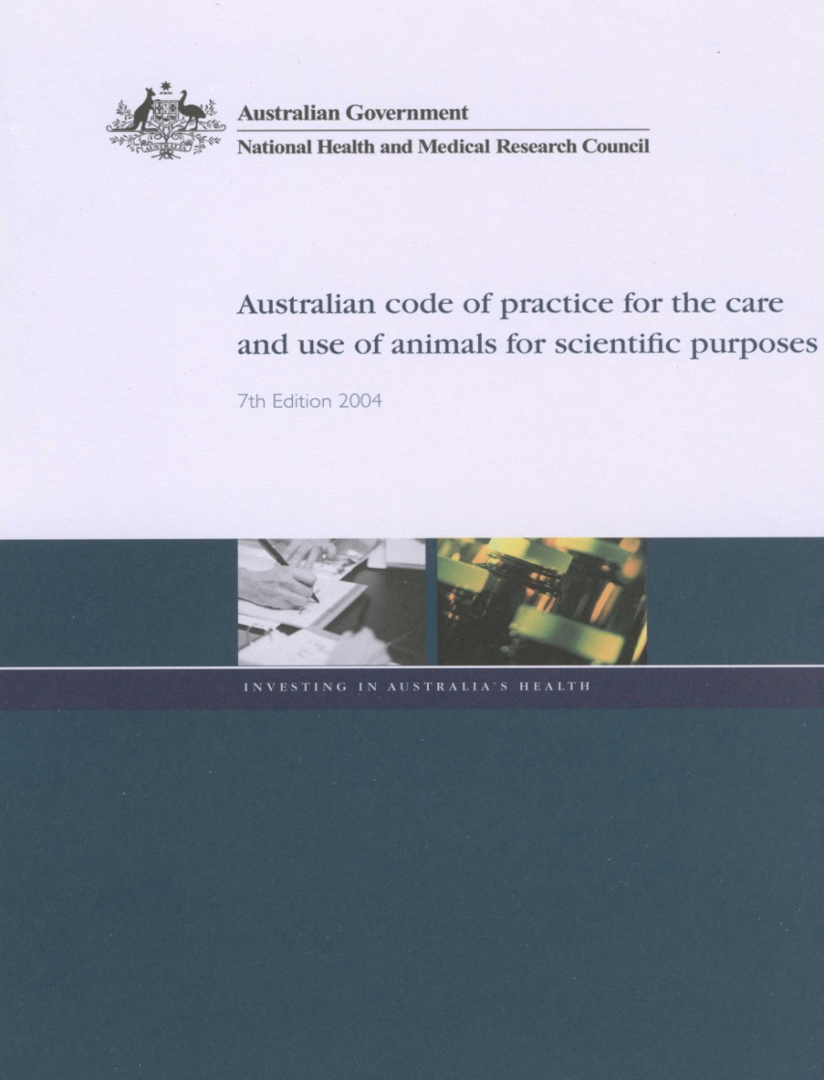
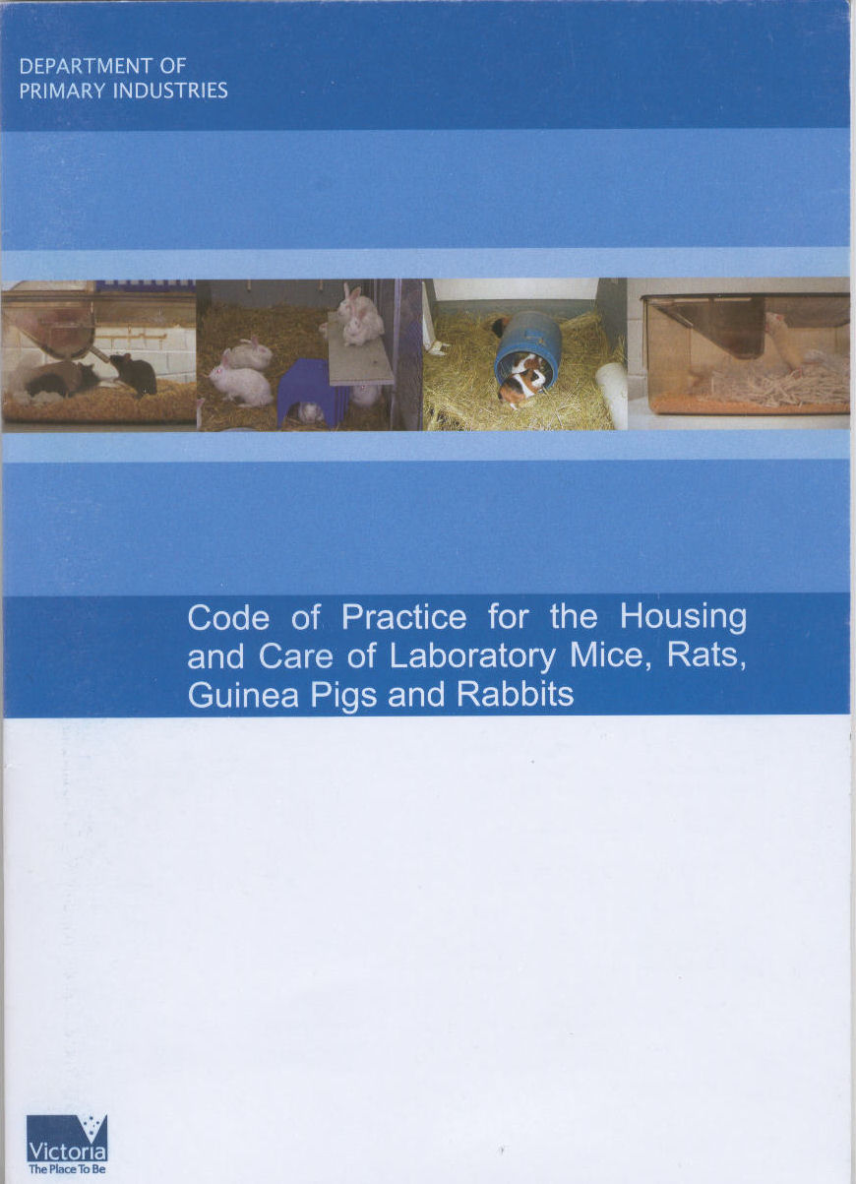

Documents relevant to scientific use of animals
http://www.nhmrc.gov.au/publications/synopses/ea16syn.htm
http://www.dpi.vic.gov.au/dpi/nrenfa.nsf/LinkView/D627198CBC669D0ACA256EE7007B68DF51F52E6260BC77B8CA2572B10008EED4
http://www.australiananimalwelfare.com.au/home
Notes:
I recommend you read Section 3 of the Code as it is a requirement for AEC approval to use animals.
I’m not going to discuss animal ethics in any detail as there is a course on tomorrow that you should all be going to and I’ll provide those details later.
Dealing with emergencies
ensure contact details are made available to us including afterhours numbers/mobiles

Slide 10
Animal Welfare Officer
Duties
Promote awareness of and adherence to the Australian Code of Practice for the Care and Use of Animals for Scientific Purposes (2004)
http://www.nhmrc.gov.au/publications/synopses/ea16syn.htm
Promote the 3 Rs – Reduce, Refine, Replace
Provide clinical veterinary services
Monitor animal holding facilities
Provide advice to Researchers
Animal Care Staff
The University
Animal Ethics Committees

Slide 11
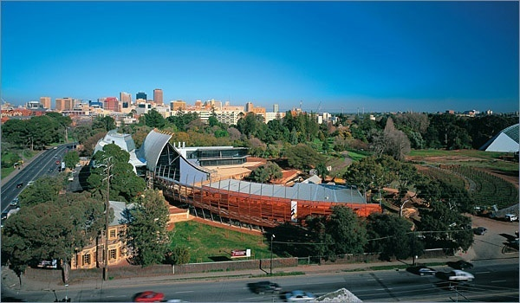
University of Adelaide processes regarding approval for the ethical use of animals
Animal Ethics Committees
Medical Committee :Secretary Amanda Camporeale (ext. 36310)
Science Committee :Secretary Helen Malby (ext. 34014)
http://www.adelaide.edu.au/ethics/animal/
Compulsory Animal Ethics Training Course
The use of animals in science: ethical considerations
UniSA City West Barbara Hanrahan Bldg (Cnr North Terrace & Fenn Place)
Friday 2th March 2012, 8.30am-12.00pm
Register on-line TODAY would be appreciated for planning purposes!
http://www.adelaide.edu.au/research/researchers/animalwelfare/user_training/
Optional Practical Training in common lab animal procedures -Handling, injection, blood collection
Mouse – Friday Feb 24, March 16 & 23, 2012
Rat – Same dates as mouse, separate sessions.
Venue: Med School South Teaching Laboratory S210
RSVP TODAY (link for on-line registration at http://www.adelaide.edu.au/research/researchers/animalwelfare/training_workshops/
(All queries to Dr Denise Noonan)

Slide 12
Australian Code of Practice
Section 3.
Responsibilities of Investigators and Teachers
Personal responsibility for all matters relating to the welfare of their animals.
the responsibility of investigators extends over all facets of the care and use of animals in projects approved by the ethics committee.
written AEC approval must be obtained before a project can begin, all AEC directives must be complied with
records of animal use and monitoring must be maintained and available for audit
Notes:
I recommend you read Section 3 of the Code as it is a requirement for AEC approval to use animals.
I’m not going to discuss animal ethics in any detail as there is a course on tomorrow that you should all be going to and I’ll provide those details later.
Dealing with emergencies
ensure contact details are made available to us including afterhours numbers/mobiles

Slide 13
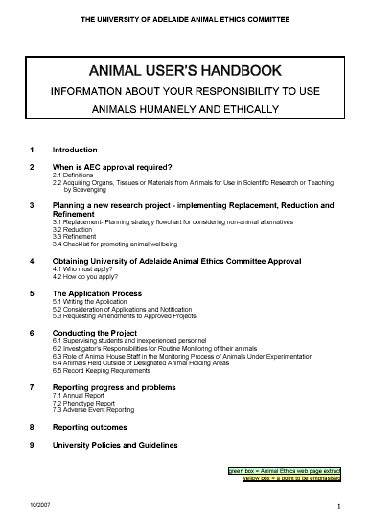
Key Resource:
Animal User’s Handbook
http://www.adelaide.edu.au/ethics/animal/guidelines/animalusershandbook/

Slide 14
Administrative Support
Faye Gardner
Office Manager
Ph. 35340
Fax. 34342
Room: S643
faye.gardner@adelaide.edu.au

Slide 15
Administrative Procedures
General Issues
Web page
http://www.adelaide.edu.au/animal_services/
Communication channels
interpersonal methods
stakeholder register
Blog
Authorisation/Security
After hours access
Notes:
the web page is a useful reference site updated regularly and containing information on Protocols/Policies/Prices/Health and Genetic Monitoring/Ethics and Welfare/Links to Lab Animal Science related sites/OHS/What’s New!
open communication policy, get to know the ACO’s within the facility you are working. It is CRITICAL you communicate clearly your requirements for the care of your animals PARTICULARLY if it is a change to the routine procedures to the Facility Coordinator, not the ACO as to avoid loss communication.
Client User Groups: Sheep/Barrier/Rodent/Dunnart etc...
E-mail: mail lists: General/specific user categories
Stakeholder Register
attending this program is part of the authorisation process
training in relevant animal handling procedures/additional training or support available from the FMs
ID card validated for facility access/alarm system training please see the Facility Coordinator to gain access.
Disciplinary Action (breach of protocol)-important for the integrity of the facility that protocols are followed-discuss your objection DON’T ignore it.
1st breach-verbal warning/2nd breach formal letter to dept Head
3rd breach suspension of authorisation to access facility
24 hour access NO entry to animal rooms before 7am and after 7pm (pre daylight savings time) unless first seeing the Facility Coordinator in order to check with other room users!!! Only red torches are to be used for lighting during the rooms dark cycle (NOT LIGHTING FROM THE CORRIDOR!!!)

Slide 16
Administrative Procedures
Involving animal use:
ethics approval
animal ordering/ technical assistance requests
http://www.adelaide.edu.au/animal_services/products/ordering.html
fee structure
internal/external clients
2012
Invoicing
Calcium (Room/Equipment Booking system) http://www.adelaide.edu.au/animal_services/
Notes:
NOTHING happens without an ethics number! The ethics approval number is required at every stage of the experimental process: ordering; delivery; cage cards; technical assistance; barrier entry; invoicing MEMORISE THE ETHICS NUMBER
we produce many of the common laboratory rodent strains
we can also source laboratory animals from other Australian and international suppliers. Please see your Facility Coordinator before ordering animals from interstate and overseas as they need to be approved prior to entering the facility. Various restrictions apply to the importation and transport of laboratory animals. Eg. Quality assurance, hot weather policy, AQIS and OGTR regulations.
show overhead of order form
EMPHASIS the importance of specifying MSAH room location REFER TO MAP
complete Notification of Biohazard and Biocontainment details as that will be matched to the requested room location.
fee structure- provide a BRIEF overview (ie. internal vs. external)
invoicing and Internal Transfer Authorisation- no code NO animals!! MEMORISE THE CODE NUMBER
monthly cage agistment charges/billing
Calcium booking system-if technical assistance is required by ACO when booking rooms or anaesthetic machines please send a event notification e-mail to the facility coordinator via the booking system.
technical assistance form: ACO are principally responsible for animal husbandry, however they will help on an adhoc basis requiring short periods of time however prior arrangements with the facility coordinator should be sought if technical assistance is required for longer periods that may impact on their duties-see price list for costs.

Slide 17
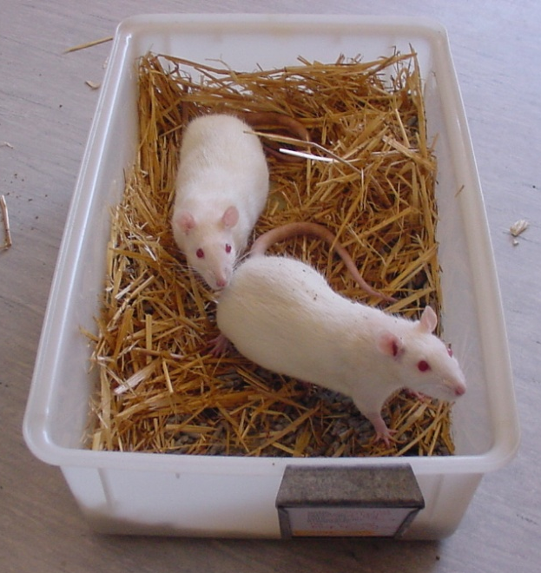
Australian Code of Practice Section 4
Acquisition and care of animals in breeding and holding facilities
4.1 Animal Acquisition
4.2 Transportation
4.3 Animal Admissions
4.4 Care of Animals
4.5 Management and Personnel
4.6 Routine Husbandry
4.7 Animal Identification
4.8 Waste Disposal
Notes:
Section 4 relates to Animal Facilities responsibilities
4.1 All animal acquisition is to be coordinated through LAS
To obtain or send interstate transports to/from non-approved facilities you need to contact me first and fill out the appropriate LAS forms for approval. Animals will not be accepted into our facilities without prior approval.
4.2 Hot weather policy – LAS have a purpose built van for transport during extreme temperatures between WAITE and MSAH. If the temperature is 30 or over hot weather policy applies
Transport from MSAH to lab – please place all rodent cages in transport boxes (large rat cages cover with drape and secure with tape) and secure the lid with tape. Not only an OGTR regulation when transporting GMO’s it also helps prevent loss of animals if cage is dropped and provides limited protection.
4.3 Animals inspected on arrival, treat if necessary
Should be acclimatised before use in a project as what is stated in your ethics application.
4.4 Facilities must be appropriately staffed, designed and maintained. i.e. trained staff, appropriate animal housing, rooms stocked, environmental parameters met.
4.5 Managed/supervised by trained/qualified animal care personnel
4.6 Routine husbandry must be performed by competent personnel
4.7 Animal’s must be identified/cage cards must be maintained including brief description of any procedure and number of animals per cage. IBC, all ethics numbers and ethics expiry date must be displayed on the cage card.
4.8 Waste must be disposed of in accordance with state legislation, placed in lined bio-hazard bins and collected for incineration.

Slide 18
Medical School Facility
floor-layout-v3.pdf
Standard Operating Procedures
1. Traffic Flows
- PC2 Barrier North (Clean Rooms & Bio-Exclusion)
- PC2 Barrier South (Bio-Exclusion & Bio- Containment)
- PC2 Isolation Room 638a
- Conventional (Rodents + PC1 rodent room)
- Conventional (Sheep)
- Disciplinary action for breach of protocol
Notes:
Floor Plan
Ø brief description of floor layout
Traffic Flows
All Barrier is PC2 certified. Once rodents exit, there is no return to barrier
Barrier North – Clean Rooms. Hepa filtered positive rooms.
Barrier North/South – Bio-Exclusion. Positive pressure rooms.
Barrier South – Bio-Containment. Negative pressured rooms.
Conventional Rodent. One PC2 rodent room
THIS INCLUDES WALK THOUGH THE CONVENTIAL CORRIDORS FROM THE 6TH FLOOR WALK WAY AND INTO THE BARRIER FACILITY!!!!
LAS Responsibilities
-daily check of all animals feed and water
-rodent cages checked once per week/changed weekly to fortnightly
-Any health concerns noticed during cage cleaning are reported via an orange cage card.
Conventional Sheep
-sheep records fill out daily
-sheep fed after 10.30am
-sheep cleaned daily
-Please send notification of intended sheep transports to the Facility Coordinator as transports need to be accepted prior to delivery
Location of shower and change rooms
Disciplinary Action (breech of protocol)
1st breech = Verbal Warning
2nd breech = Formal letter to dept. head
3rd breech = Suspension of authorisation to access the facility
After hours access – facility security alarm system is armed after hours. Do not access the facility until you have logged in on the after hours record and disarmed the zone(s) you are to enter.
Important for integrity of the facility that protocols are followed – please discuss you objection – DONT ignore it.
1st breech = Verbal Warning 2nd breech = Formal letter to dept. head
3rd breech = Suspension of authorisation to access the facility

Slide 19
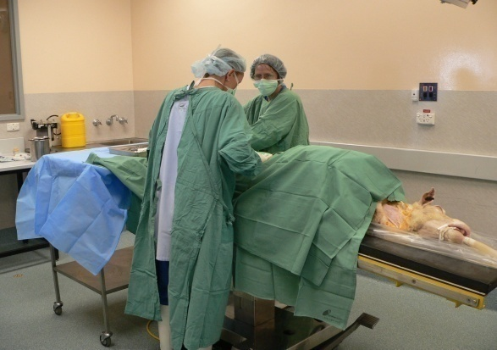
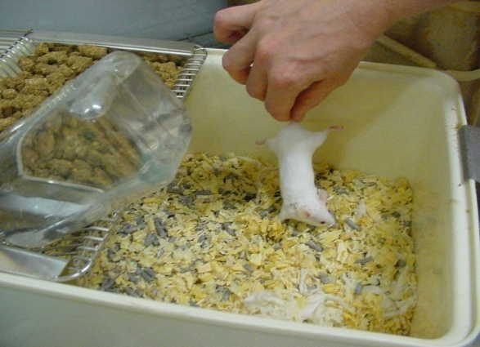
Medical School Facility
Standard Operating Procedures (cont…)
1. Gowning requirements
2. Theatre/Anaesthetic Machine Booking
3. House keeping
4. Animal Care
Animal Handling
Notes:
Gowning
Please follow all gowning guidelines as there are different gowning requirements for “Clean rooms”, “Bio-Exclusion and “Bio-Containment rooms”. Don’t forget to obtain a pair of barrier shoes prior to using the barrier facility. Failure to follow the gowning requirements will result in disciplinary action.
Thousands of dollars, time and effort are invested in all of your projects and animals which we are only trying to protect. Please don’t put your and others research at risk. If you see anyone not adhering to the protocols mentioned, please let me know. I understand there is a lot of information to absorb and we are only human, mistakes can happen. However repeated offensive will be dealt with.
Theatre Use
Equipment and rooms need to be booked on the calcium booking system. You need to send an e-mail notification if assistance is required by 2pm Friday for the following week. Include your contact number when booking so that you can be contacted if there is a clash. Please organise a meeting with Faye Gardner to gain access
If ANY technical assistance is required please send a technical assistance order to Faye Gardner. Failure to do so will may result in inability to provide technical assistance required! Please give notice by 2pm Friday for following weeks assistance to ensure staff are available.
We can not guarantee surgical packs will be autoclaved ready for use if 24hrs notice and supply is not given.
House Keeping
LAS Responsibilities
Researchers Responsibilities-cage numbers, monitoring
Animal Health Reporting

Slide 20
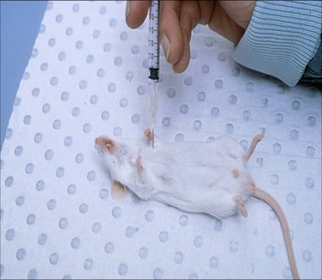
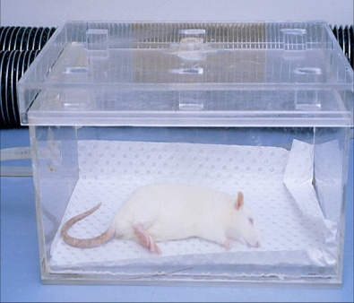
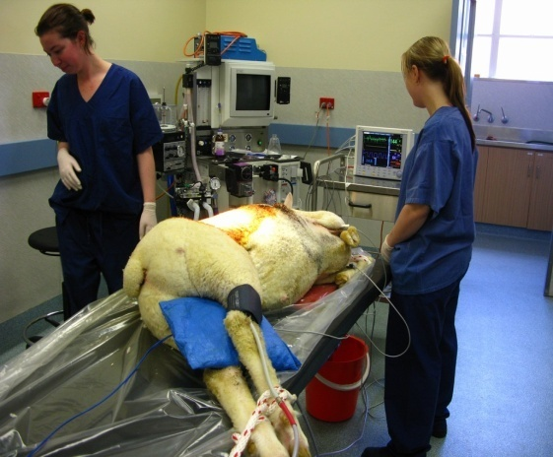
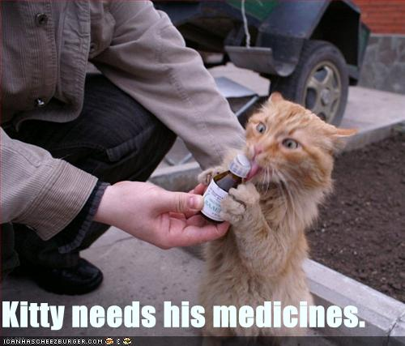
Medical School Facility
Technical Assistance – what the medical school facility can provide
Maintain GMO and inbred breeding colonies to OGTR regulations.
Tail biopsies
Time mating (including plug checking)
Identification
Orbital eye/facial vein blood collection
Cardiac blood collection
Gavaging
S/C, I/M, I/P injections of all species
Tail vein injection
Jugular vein injecting (sheep)
Anaesthetising all species (including pre and post operative care)
Notes:
Laboratory Animal Services can provide a range of technical assistance.
They are:
Maintain breeding colonies both GMO and inbred
Tail biopsies
Time matings
Identification
Orbital eye/facial cheek vein puncture blood collection
Cardiac blood collection
Gavaging
S/C, I/M and I/P injections of all species
Jugular vein injection (sheep)
Anaesthetising of all species (including pre and post op care
Please remember to send Faye a technical assistance form or e-mail notification if booking via booking calendar by 2pm Friday if assistance is required the following week. Failure to do so may result inability to provide LAS staff to carry out extra tech assistance duties.

Slide 21
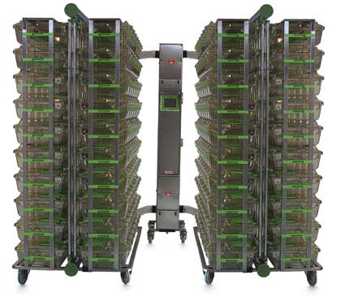
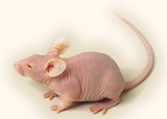
Waite Campus Animal Facilities
SPF Barrier Production
Inbred Strains available- C57/Bl6, Balb/c, CBA, Nude, SCID, DA, RT7B
Outbred- Swiss, SD, AW, HW
Hybrid- CBA F1
Nude and SCID colonies established in the Individually ventilated cages (IVC)
Standing and advance orders are given priority
Animals available from Birth to 8weeks
Ordering by age / weight
Notes:
The following mouse strains are available Balb/c, CBA, SCID, Swiss, C57, CBA F1. Nude and SCID colonies have been established in the IVCs, all other mouse strains will be caesarean derived into IVCs.
Standing and advance orders are given priority, if you are able to determine your animal usage we will do our best to accommodate you
Orders must be submitted by 4.00pm to Faye the previous day. Late orders can be delivered at your cost by courier.
If the temperature is over 30oC late orders will have to wait until the following day with no exception.
Rodents can be ordered either by specific age or specific weight.
We can supply any age range from birth up to 8 to 10weeks depending on the strain. If older animals are required, advance notice is necessary (i.e. 1wk for 11wks etc)
For animals at a specific day e.g. 21d, you will need to place an order 3 weeks in advance, birth dates are approximate once animals have been weaned they are group housed. In that instance we will weigh them and provide animals with weights that are representative for the age
Ordering by age will not guarantee a specific weight, a range should be provided at all times. Animals of a specific weight will incur 10% surcharge

Slide 22

Waite Campus Animal Facilities
SPF Barrier Production
Time Matings - 3 days notice prior to mating - Day 0 is plug day
No guarantee that the animals will mate on the specified day
No guarantee that the animals will be pregnant when a plug is found
Large Orders
- should be placed in advance
- allow age or weight range
Notes:
Time Matings
Min 3 days notice should be provided for small numbers, advance notice is required if more than 8 positives are required as we may not have enough virgin females available for mating
We can supply pregnant rats or mice at any day post coitus with Day 0 being plug day.
When ordering time mated animals there is no guarantee that animals will mate on the day required, or that the required number of plugs will be obtained.
Once plugged there is no guarantee that they will be pregnant, if you require the animals at approx day 13 we will palpate them. You will be notified if we do not have the number of animals you require or do not appear to be pregnant.
Large Orders – must be placed in advance and given priority
Due to the differing sizes and demands of our breeding colonies, it is essential that weight and age ranges are provided to prevent delays. Remember that specific weight ranges will incur a10% surcharge

Slide 23
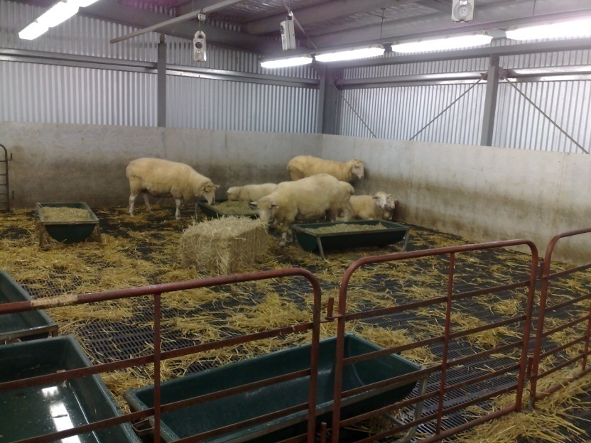
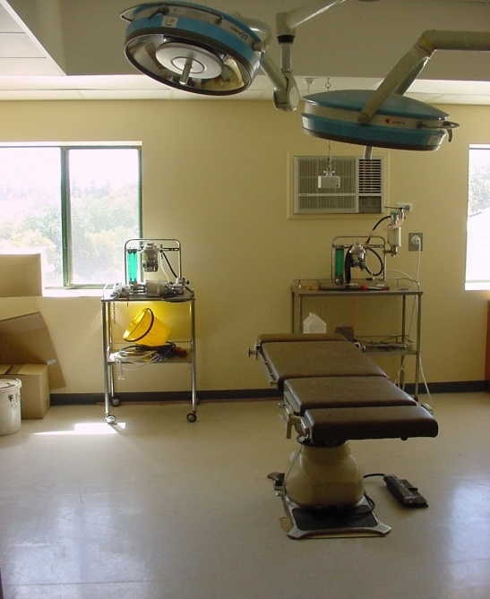
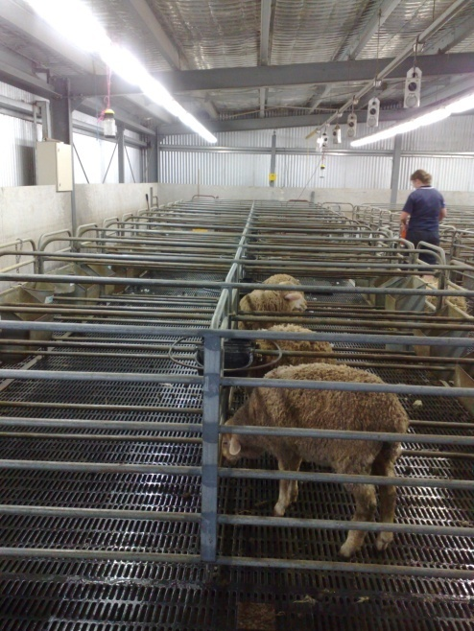
Livestock Research Centre LRC
56 pens
Additional 20 pens able to be converted to 10 double size pens
Surgical suite
Booking of pens through LAS
Notes:
Total Capacity approx 90 sheep, currently there are 56 pens with an additional 20 larger pens, which can be converted to 10 “lambing” pens available. Bookings must be made through LAS to ensure that there is sufficient space.
We offer full husbandry support including daily feeding and cleaning as well as more specific technical assistance as required. We also offer the shed as a holding facility only (once approved by ethic committee).
Discuss needs with Las.
There is also a surgical suite available for use

Slide 24
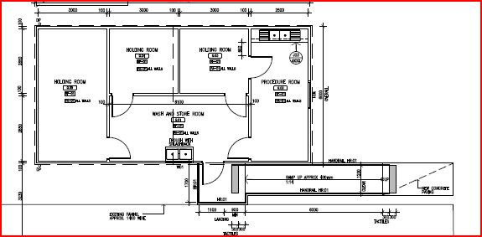
Small Animal Research Facility
3 Animal holding rooms plus procedure room
Notes:
Small Animal Research Facility located at Roseworthy - New facility consisting of 1 large and 2 smaller animal holding rooms plus a procedure room.
Bookings for rooms through LAS and in future possibly online through calcium.
Discuss individual requirements with LAS.
Any technical required through online technical assistance form.
We are looking into the possibility of a PC2 room within this facility.

Slide 25
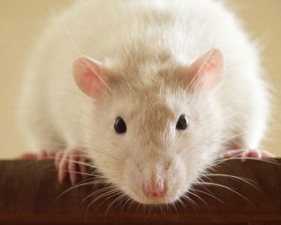
Office of the Gene Technology Regulator - OGTR
The Gene Technology Act 2000
Cage Cards
Must include IBC Number
PC1 Medical School
Conventional Room 658
PC2 Medical School
All Barrier and Containment Rooms
Conventional Room 644
Gowning Requirements
http://www.ogtr.gov.au/

Slide 26
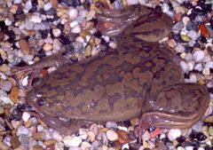
Australian Quarantine Inspection Service - AQIS
AQIS import certificate required before import
Notification to Facility Co-ordinator
Current Ethics approval
OGTR licence
IBC Number (if Genetically Modified)
In-house Import Form
Health reports
Quarantine Act 1908
Waite Campus
Xenopus room
Medical School
Room 632a Barrier Containment and Isolation Room 638

Slide 27

Legal Compliance
Animal Welfare Act (1985)
Controlled Substances Act (1984)
Dangerous Substances Act (1979)
Gene Technology Act (2000)
Livestock Act (1997)
Quarantine Act (1908)
Radiation Protection and Control Act (1982)

Slide 28

Health, Safety and Well-being
Branch Policy
Hazards associated with animal work
manual handling
bites, scratches and kicks
research activity
Evacuation Procedures
animal experiments
alarms
emergency exits
Client Responsibilities

Slide 29
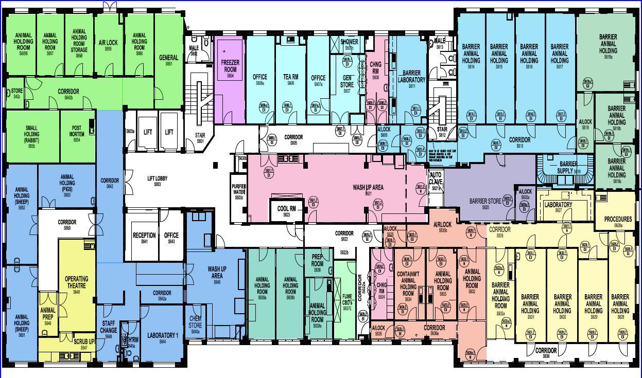
Evacuation Points

Slide 30
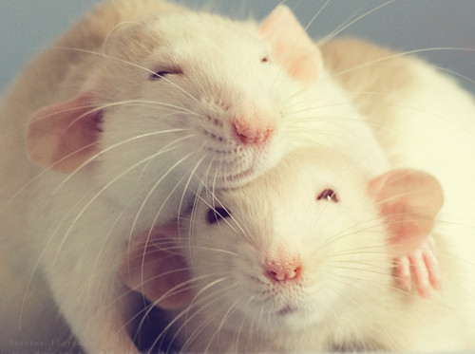
Genotrack
Breeding Colony Maintenance Software
breeding
weaning
matings
statistics
ethics
health care
Web based software
need to be issued with a licence and password
Available for researchers to use

Slide 31
Questions
…mmmmm?

