Slide 1
Active and Passive Voice
Dr Julia Miller
English for Uni
www.adelaide.edu.au/english-for-uni

Slide 2

The teaching materials in this PowerPoint presentation have been developed by Dr Julia Miller and are available on the English for Uni website.
Funded by the Australian Government Office for Learning and Teaching.

Slide 3
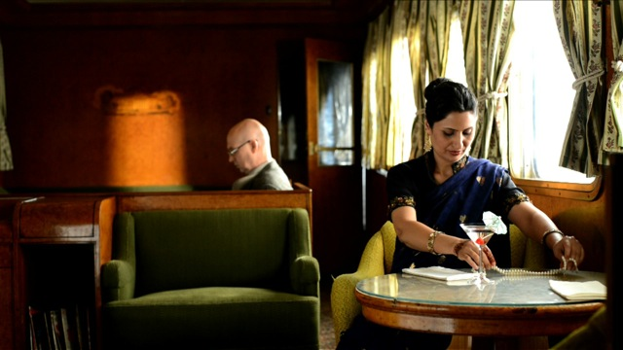
Stolen on the Outback Express
Please click on the photo above to go to the Stolen on the Outback Express video
What grammatical feature is the focus of this story?
Notes:
Play the start of the video story using excerpt/chapter 2, The Passives Story, as a warm-up for the class. (N.B. If you are using the complete video, rather than the video chapters, start at 1:15 after the passives song.) Stop part way through the story, at the point where Professor Grahamarian says “Dear dear. I think we should get Ms Parrot to come and help”. (This is at 2:34 in the chapter 2 video, or 3:49 in the complete video.)
Click on the photo to start, or paste this link into your browser:
https://www.youtube.com/watch?v=j8eIWG3Bf-w&feature=youtu.be&list=PLrj2iJKdUdbzmSkwVoc03-UBGwuIZUj7g

Slide 4
Active and passive
The active voice tells you what the subject of a sentence does.
The passive voice creates a new subject.
The active voice is more common than the passive.
Active: Robin started the group project.
Passive: The group project was started by Robin.

Slide 5
Transitive and intransitive
Only transitive verbs (verbs which take a direct object) can be made passive.
If you are not sure if a verb is transitive or intransitive in English, try putting an object after it.

Slide 6
Transitive
SUBJECT VERB OBJECT
started
What did Robin start?
Answer: the group project
The verb ‘start’ can take an object, so it is transitive.
Robin
the group project

Slide 7
Intransitive
SUBJECT VERB OBJECT
laughed.
What did Robin laugh?
Answer: Nothing. You cannot laugh something.
The verb ‘laugh’ cannot take an object, so is intransitive.
Robin

Slide 8
Some verbs are transitive and intransitive
I ran the race (transitive)
I ran (intransitive)
If you want to know if a verb is transitive or intransitive, look in a learner’s dictionary of English.

Slide 9
The object of the active sentence becomes the subject of the passive sentence.
SUBJECT VERB OBJECT
started
SUBJECT VERB was started
Robin
the group project.
The group project
by Robin.

Slide 10
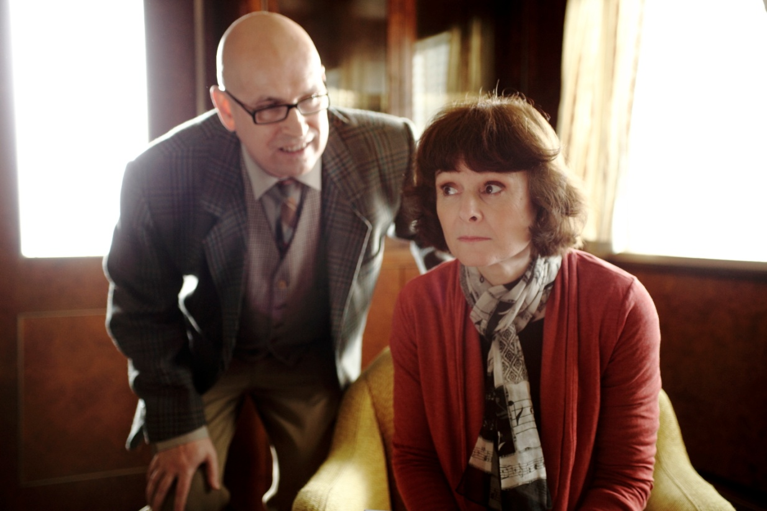
What other examples of the passive voice can you find in the story?
Please click on the photo above to go to the Stolen on the Outback Express video
Notes:
Look for passive voice examples in the rest of the story. Play the story through to the end and stop at the teaching section.
Click on the photo to start, or use this link:
http://www.youtube.com/watch?v=j8eIWG3Bf-w&t=2m34s

Slide 11
What verbs are in this song? How are they used?
Please click on the photo above to listen to the passives song
Notes:
Play the passives song. What other type of verb is there? Click on photo to show song, or paste this link into your browser:
https://www.youtube.com/watch?v=WekIFyO5OLI&feature=youtu.be&list=PLrj2iJKdUdbzmSkwVoc03-UBGwuIZUj7g

Slide 12
The verbs in the passives song
I used to be so passive
Every door was closed to me. (passive)
I used to be so passive
No door was opened to me. (passive)
Then the door opened (ergative)
It opened ergatively. (ergative)
So I pushed it open (active)
I opened it actively. (active)
Now I'm no longer passive
I open every door that I see. (active)
No, I'm no longer passive
The door is wide open for me.

Slide 13
Ergative verbs/The middle voice
1) Robin started the group project. – Active
2) The group project was started by Robin. – Passive
3) The group project started. – ?
Sentence 3 uses an ergative verb. An ergative verb can change an object into a subject without needing to use a passive. This is sometimes called the ‘middle voice’.

Slide 15
Why do I need to use ergative verbs?
Sound more like a native speaker of English.
1) Robin started the group project. – Active.
Emphasis on the person responsible who started the project.
2) The group project was started by Robin. – Passive
Emphasis on the group project and on the fact that someone started it, rather than on the person who started it.
3) The group project started. – Ergative verb
Emphasis entirely on the action. We do not know who is responsible.

Slide 16
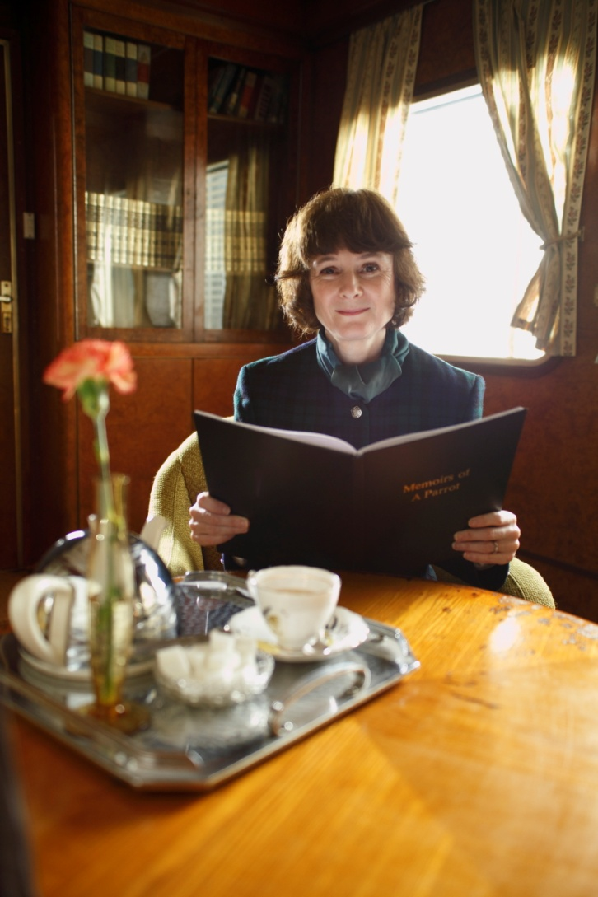
Notes:
Play the teaching section of the video. Click on the photo to go to the video online, or paste this link into your browser:
http://www.youtube.com/watch?v=PYNFhaeFPfk&t=4m55s

