Slide 1
Tenses in Academic Writing
Dr Julia Miller
English for Uni
www.adelaide.edu.au/english-for-uni

Slide 2

The teaching materials in this PowerPoint presentation have been developed by Dr Julia Miller and are available on the English for Uni website.
The grammatical content of the materials is largely based on Celce-Murcia, M., & Larsen-Freeman, D. (1999). The grammar book (2nd ed). US: Heinle & Heinle.
Funded by the Australian Government Office for Learning and Teaching.

Slide 3
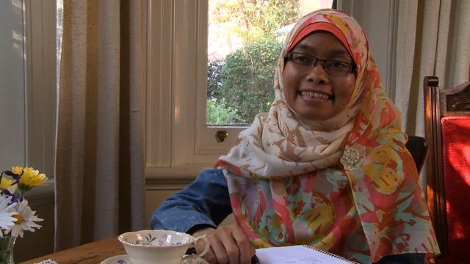
What questions do you have about verb tenses in English academic writing?
Please click on the photo above to go to the video
List the names of the verb tenses you know in English.
Notes:
Click on photo to go to video, or paste this link into your browser:
http://www.youtube.com/watch?v=p7lZwtozA_g&t=0m11s
Pause before the talent show, at 0:33

Slide 4
Tenses in English
 | Simple | Perfect | Continuous/ Progressive | Perfect Continuous/ Progressive
 | - | have + past participle | be + -ing | have + past participle + been + -ing
Present | claim/claims | has claimed | am/is/are claiming | has/have been claiming
Past | claimed | had claimed | was/were claiming | had been claiming
Future | will claim | will have claimed | will be claiming | will have been claiming

Slide 5
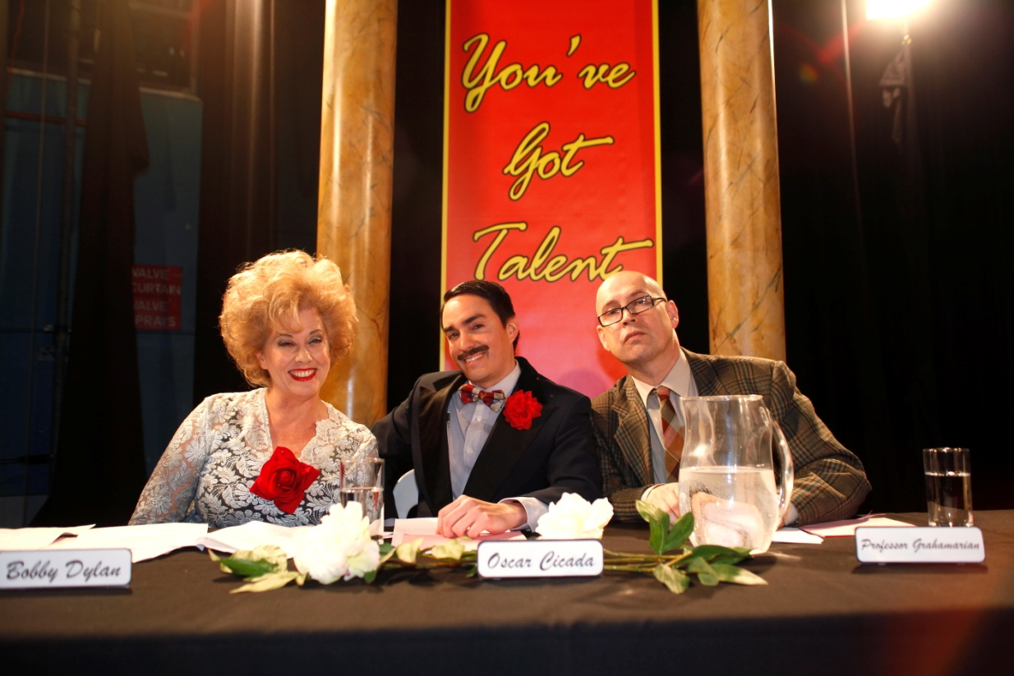
What different verb tenses are in the story?
Please click on the photo above to go to the talent show
Find an example of present simple, past simple and present perfect
Notes:
Play the talent show part of the video. Click on photo to start at the correct place, or paste the link below into your browser:
http://www.youtube.com/watch?v=p7lZwtozA_g&t=0m33s

Slide 6
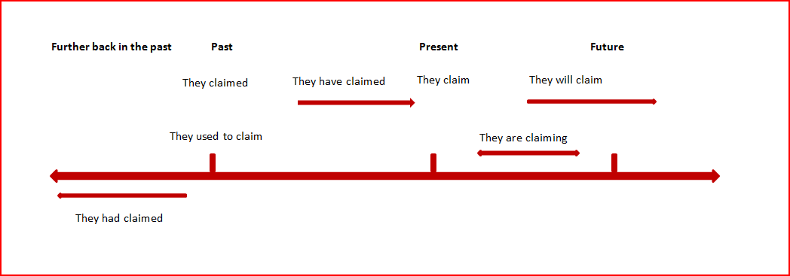
Tenses timeline

Slide 7
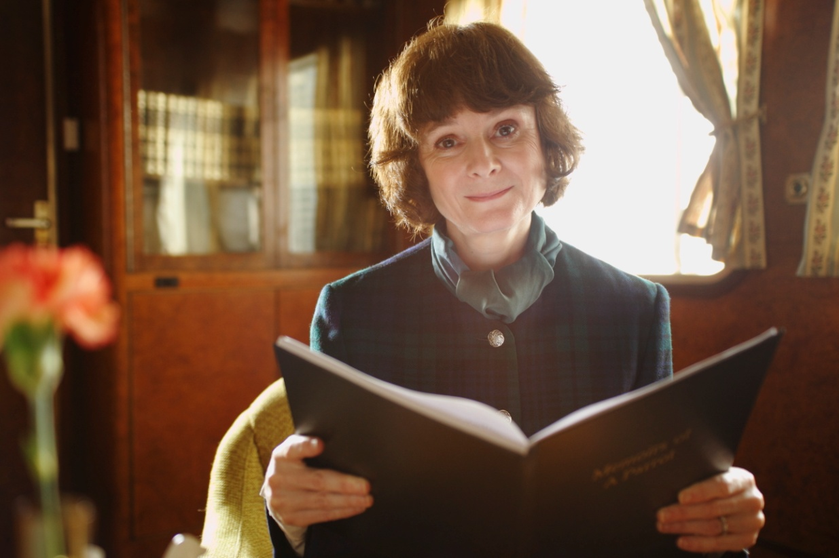
Teaching about tenses
Please click on the photo above to go to the video
Notes:
Click on the photo to go to the teaching section of the video, or paste this link into your browser:
https://www.youtube.com/watch?v=-iQJDlkiYJs&feature=youtu.be&list=PLrj2iJKdUdbwkXm2rCmm1ufBPzh47jobw

Slide 8
Examples of tenses from the video story
Present simple
- A general principle
Talent shows usually allow people to demonstrate their creative abilities.
- Someone's opinion
Professor Grahamarian thinks that talent shows are important.
- The results of an experiment
The judges' scores show that X is the clear winner.
- A habitual action in the present
People nearly always feel nervous before they perform on stage.

Slide 9
Present simple (continued)
- A theory
Bobby Dylan's theory about talent contests is that one should not judge by appearances.
- A claim
Bobby Dylan claims that talent shows are the best way for people to become famous.
- A fact
Talent shows are exciting.

Slide 10
Past simple
- What happened
There were two acts. Prince Wolfgang won the competition.
- What happened in the past but is different now
In the past, shows were simpler.
- Ideas that were held in the past but are no longer held
People thought that talent contests were bad.
Used to is also used to compare the past to the present
People used to win smaller prizes.
[This implies that the situation has changed.]

Slide 11
Present perfect
- Something that has changed over time
Recently, talent contests have become bigger and more glamorous.
- Recent research and its present impact
Recent research has shown that talent contests can make people nervous.

Slide 12
Stative verbs
These are verbs that refer to states or preferences rather than to physical actions. They are not normally used in continuous or progressive forms.
Stative verbs
agree | involve | realise
appear | know | recognise
believe | like | resemble
consist | love | seem
constitute | mean | understand
doubt | need | want
hate | own | weigh
include | prefer | wish

Slide 13
Exercise. What tense would you use to describe:
1. a general principle
2. what happened in an experiment
3. ideas that were held in the past
4. something that has changed over time
5. someone’s opinion
6. the results of an experiment
7. a habitual action in the present
8. recent research and its present impact
9. a theory
10. a claim
11. a fact
Notes:
This is exercise 2 from the website.

Slide 14
Answers to exercise
1. Present simple
2. Past simple
3. Past simple
4. Present perfect
5. Present simple
6. Present simple
7. Present simple
8. Present perfect
9. Present simple
10. Present simple
11. Present simple

