Slide 1
Phase 1: Engage
The Values & Behaviour Framework

Slide 2
Phase 1 : Engage Toolkit
This is a Values and Staff Behaviour toolkit designed for leaders of both staff and students.
The toolkit provides guidance to leaders on how to implement the values framework and encourage our staff and students to live the values in action.
The toolkit provides an overview of the implementation journey but focuses predominately on phase 1: Engage

Slide 3
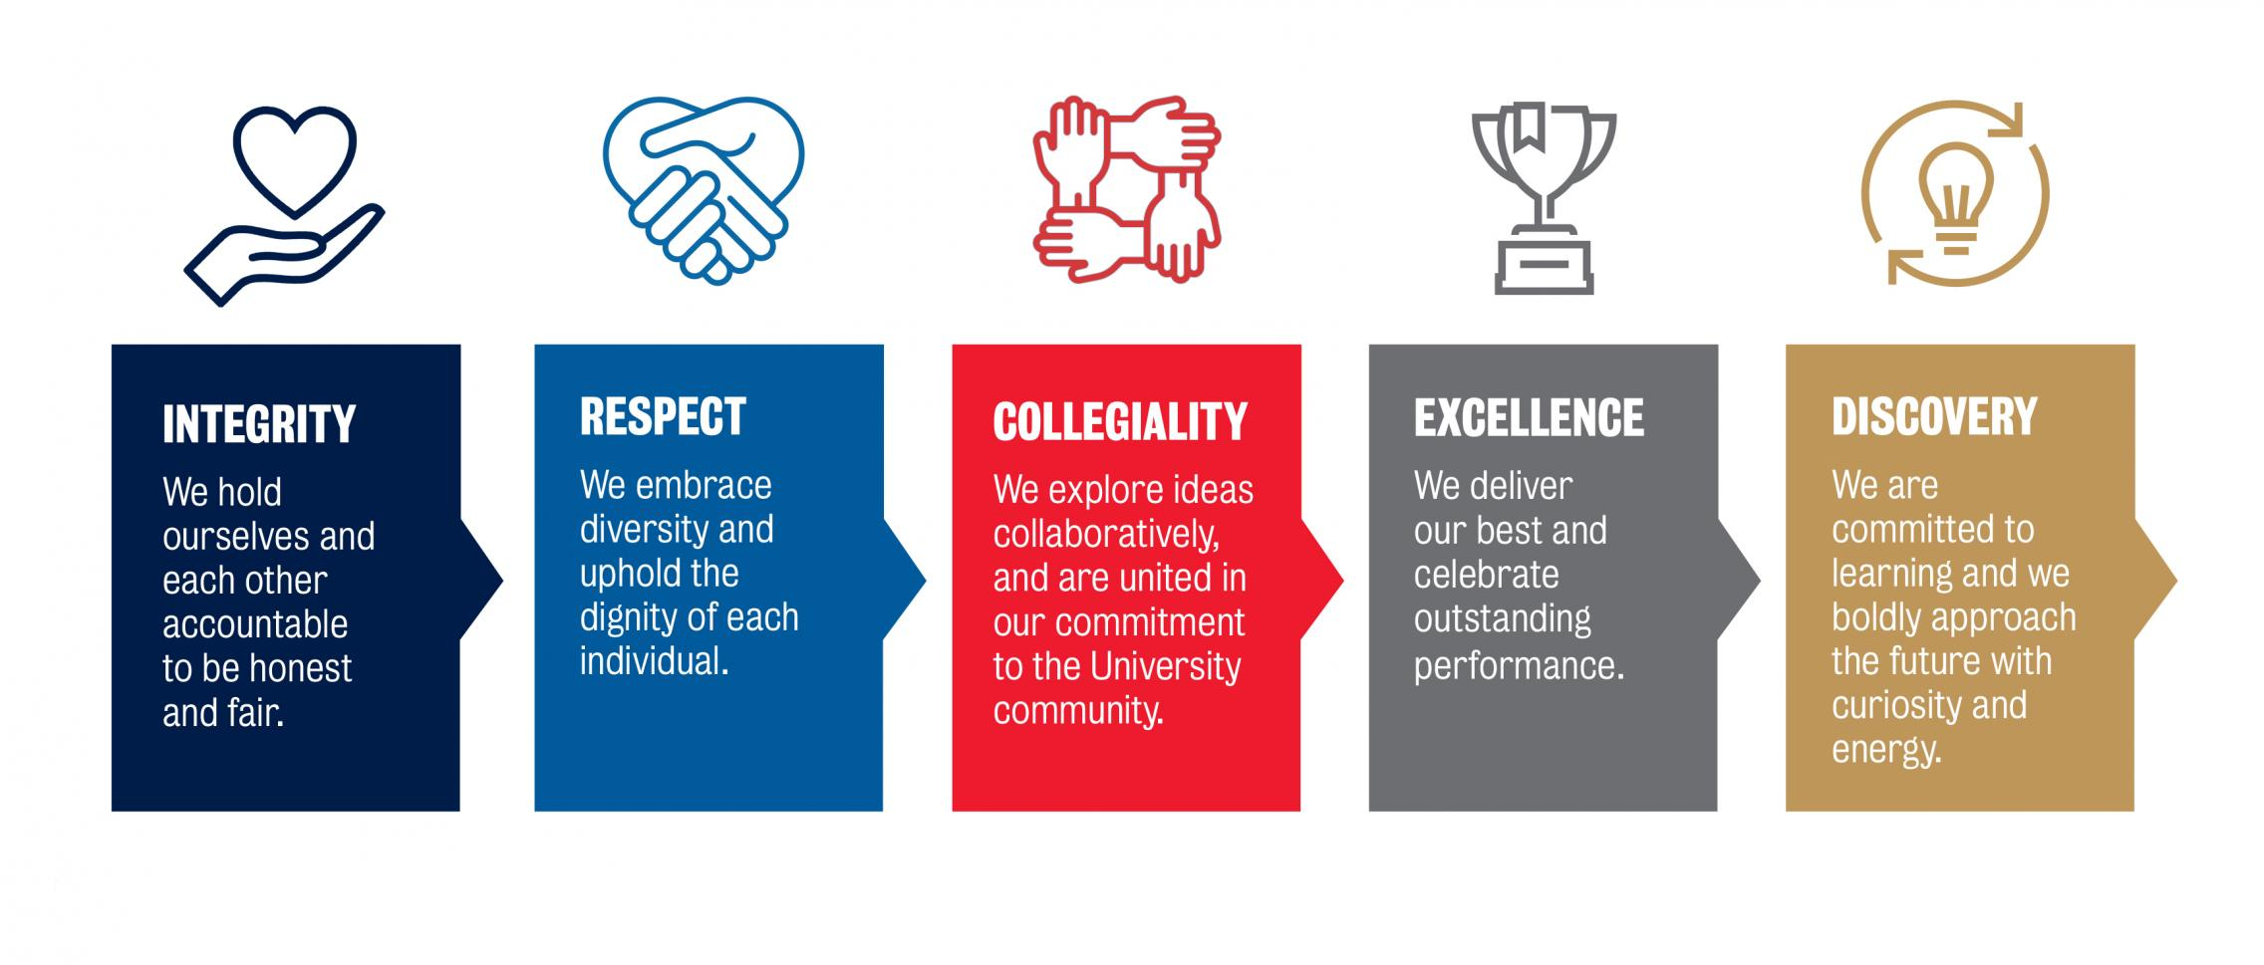
Why is culture and Values important?
Organisational culture is defined as a set of beliefs, values and assumptions that are shared by members of the organisation. These underlying values have an influence on the behaviour of organisational members, as people rely on these values to guide their decisions and behaviours.
Organisational culture can influence the behaviour of organisational members. This behavioural influence exists because individuals behave in ways that are consistent with their values, and organisational culture is a set of shared values. It is important for an organisation to create behavioural expectancies that direct staff to behave in ways that are consistent with its culture or future desired state.
The toolkit has been created to strengthen staffs understanding of the Values and Behaviour framework and live our values in action.

Slide 4
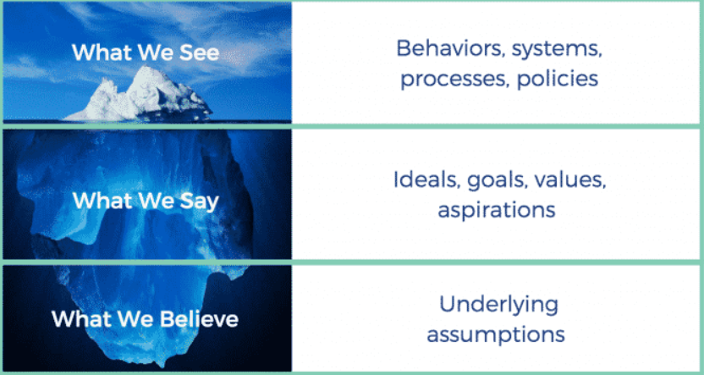
The role of leaders and culture
Leaders play a critical role in using their behaviour by setting the tone of what is acceptable and what is unacceptable within an organisation. Leaders have a responsibility to help define, teach, live , measure and reward the culture that they want to build.
The more leaders can share with staff what the University values in its culture, the easier it will be for the culture to become a reality and not just random words.
This toolkit has been created for leaders to use to promote the values and behaviours and implement them across their teams.

Slide 5
University Values
Notes:
INTRODUCING THE VALUES
- These are our University Values.
Share personal story/ stories of a time when you have experienced/ demonstrated/ witnessed values & behaviours that have positively impacted you or others in the workplace, (and/or, when a particular value or behaviour has not been demonstrated, and the adverse impact it had on you or another). You may like to invite other staff, (such as others members of your leadership team) to also share a story which impacted them in some way.
Context
Integrity means: Our behaviour should align with University Values, the Code of Conduct, policy and procedure, with behavioural standards applying equally to all staff without exception. When behaviour contravenes these standards, it needs to be called out and addressed. Behaving with integrity means acting honestly and fairly, showing individual accountability for our actions, making ethical and evidence-based decisions in the interest of the University and those around us.
Respect means: Most prominently, demonstrating Respect means embracing and recognising the strength in diversity – across level and role type, gender, culture, ethnicity, sexual orientation, ability, background, experience and education. Respect means proactively creating an inclusive environment, and not tolerating ignorance or bias. Respect is about showing and communicating with empathy, professionalism and concern for others, attending to individual needs, and valuing each other’s time, opinions and contribution.
Collegiality means: Promoting and facilitating collaboration across teams, the University and broader community, is key to achieving Collegiality. This includes by sharing knowledge and resources, openly discussing new ideas and discoveries, and rewarding mentorship, enabling activities and successful collaborations. Collegiality requires a breakdown of organisational silos, and demonstrating commitment to the University community. Integral to achieving Collegiality is our ability to seek out a diversity of views and critically and respectfully evaluate those different ideas and opinions.
Excellence means: Excellence includes a commitment to strive for the best possible outcome, within a supportive environment which responds to set-backs and challenges as learning opportunities. Celebration of individual and team performance excellence, and the contribution that we each make across all levels and functions is an important part of this. Importantly, recognising that achievement is as much about what you do as how you do it, and demonstrating the Values’ through the way we behave, interact and conduct ourselves in the workplace is an important hallmark of Excellence.
Discovery means: Discovery means embracing an experimental mindset, being innovative and ready to adapt to changing circumstances and new opportunities. Part of this includes embracing an appropriate risk appetite, challenging the status quo, and being rewarded for innovation independent of outcome. With Discovery, we create space for and celebrate learning in and of itself.

Slide 6
OUR VALUES IN ACTION
Together with the Code of Conduct, the Staff Values and Behaviour Framework enshrines the University's Values and a set of key behavioural standards that uphold our University's culture.
Integrity
Respect
Collegiality
Be accountable for my outcomes and actions, and encourage other to do the same.
Make decisions in the interests of the University, based on the best available evidence and with consideration of the needs of others.
Behave in accordance with University Values, the Code of Conduct, and the standards expressed by this Framework.
Address behaviour which falls short of our standards, and support others to do the same.
Taboo:
Make allowances for lapses in ethical
and moral conduct.
Recognise and appreciate that the valuable contributions people make are influenced by diverse backgrounds, experiences and capabilities.
Enable the views of others to be heard and genuinely value their input.
Demonstrate empathy and concern for others by making time to understand their unique needs.
Communicate with each other in a positive, constructive and professional manner.
Taboo:
Tolerate bias, exclusion or wilful ignorance
in any form
Create opportunities for collective idea generation, knowledge sharing, and decision making.
Generously pitch-in to support each other, our communities and the University, and participate in local and whole of University events.
Encourage active challenge of assumptions.
Welcome and explore competing views through reasoned and robust debate.
Taboo:
Promote self-interest above what matters to the whole of University, and not own institutional decisions.
Notes:
Facilitator notes
Together with the code of conduct, the staff values and behaviour framework enshrine the University’s values and a set of key behavioural standards that uphold our University’s culture. The behaviour framework provides guidance on how we can live our values in action and encourage our staff (and students) to demonstrate a deeper understanding of our desirable and undesirable behaviours.

Slide 7
OUR VALUES IN ACTION
Together with the Code of Conduct, the Staff Values and Behaviour Framework enshrines the University's Values and a set of key behavioural standards that uphold our University's culture.
Discovery
Excellence
Challenge myself and support colleagues to meet and exceed performance expectations.
Celebrate the people and teams that show perseverance, commitment, risk taking and achieve great results (no matter how small or large).
Celebrate those who consistently ‘live’ University Values.
Take responsibility for giving timely and specific feedback to others.
Taboo:
Accept mediocrity in effort and output.
Show energy and drive to pursue new opportunities and challenge the status quo.
Demonstrate an experimental mindset, take risks and explore new ways of doing things.
Take responsibility for my own professional learning.
Reward innovation and initiative independent of outcome.
Taboo:
Shut down new ideas without affording them time to be
heard, built on and valued.

Slide 8
Implementation of the Values and Behavioural Framework
Positive Workplace Culture
Leadership Accountability
School and team accountability
Clear Values and Behaviours
Transforming Culture Initiatives
Organisational Development Strategy
Phase 1: Engage
Phase 2: Enable
Phase 3: Sustain
Notes:
To create a positive workplace culture, we need to have clear values and behaviours that are understood and demonstrated within our University. To implement our values and behaviours, we all need to take accountability and encourage our staff (and students) to live the values in action. To do this, we must engage with the key people that we work with and explore what the values mean to us and create a set of shared values that encourage our staff (and students) to behave in ways that are consistent with our culture.
Initiatives from the Transforming Culture project and the Organisational Development Team will continue to strengthen our workplace culture.
Phase 1 of this toolkit is focussed on engaging and socialising the values.

Slide 9
Socialising and living the values in action
Phase 1 Engage
Define the Values
Define the outcomes
Communicate the Values
Celebrate
Phase 2 Enable
Model the Values
Recognise
Reward
Phase 3 Sustain
Reinforce the Values
Live the Values in action
Notes:
There are 3 key phases that need to be undertaken in order to socialise our University values. Phase 1 is focussed on engaging. The toolkit provides examples of how you can engage with your teams/students and encourage them to live the values in action. Phase 1 focusses on defining the values, the outcomes and then communicating the values.
Phase 2 focuses on enabling. Once you have engaged with your teams/students to understand what the values mean to you, you can then start modelling the values.
Phase 3 focuses on sustaining. As you begin to model the values, it is important to continually reinforce the values and encourage everyone to live the values in action.
Throughout each phase, it is important to celebrate, recognise and reward staff/students that live the values in action.

Slide 10

Phase 1: Engage - Define the Value
Identify the desired behaviours associated for each core value
What are examples of behaviours that are in line with the intent of the value?
What behaviours are aligned with the culture you are designing?
What are the undesirable behaviours with each value?
What do the values mean to you?
The above can be defined at an Executive, Director, School, Branch and Team level
Start your first team meeting defining what the values mean. Once you define what the values mean to you and your team members, modelling the behaviour in the future becomes easier

Slide 11
Phase 1: Engage - Define the Outcome
For each value and behaviour, define the desired outcomes, including outcomes of operationalising the values versus what happens if employees don’t align with the value.
Having the behaviours and outcomes clear, provides staff with a clear picture of why each value is important to the organisation and allows them to align (or not which may be the case).

Slide 12
Communicating the values
Focus on a core value per month
Select a core value and dedicate the month to talking about what it means, sharing stories about employees who have lived the core value, providing examples to employees
Have a lunch and learn dedicated to all things about that value
Ask employees about what that value means to them
Put the values in meeting rooms, kitchens
Talk about values at the beginning of meetings, training
Set time aside at a school/branch/team meeting to focus on the values only.

Slide 13

Celebrate, Recognise and Reward
When staff live a value in action, reward them through the ‘Recognise a Colleague initiative’
When staff live the values in action, celebrate this as a team
Develop an internal recognition program that recognises staff living the values in action. Dedicate forums, school and team meetings to recognise this.
Continue to discuss the values in your PDR conversations and set SMART goals that relate to living the values in action.
Recognise a Colleague initiative - Show your appreciation for what your staff do and the way they do it - https://www.adelaide.edu.au/hr/organisational-development/university-values/recognise-a-colleague

Slide 14
Supporting our Students to live the values in action
It is important to ensure that both students and staff are living the values in action. Staff that promote different philosophies to students can influence the way that students understand each of the values both positively and negatively.
At the start of each semester, talk to your students about the values. Once you have engaged with your staff about what the values mean and defined examples of these values in practice, share these with your students. Explain to your students what the values mean to you as a Faculty/School/Team.
Begin lectures with the values framework and attitudes
Celebrate and recognise students that actively live the values in action

Slide 15
STAFF AND STUDENT ATTITUDES
The ATTITUDES chart provides further suggestions on how we can live our values in action
A
T
T
I
T
U
D
E
S
Be Approachable positive and supportive.
Create a safe space for people to execute ideas
Take the time to recognise your emotions and the effects they have on you and others
Tone
Be mindful of the tone of your voice.
Information and Knowledge sharing. Recognise the overlap in knowledge and expertise from different disciplines
Teamwork encourage team cohesiveness and creativity through team commitment and the identification of mutual goals
Understand and seek other people’s perspectives-Embrace different ideas and opinions without judgement
Disagree without being disagreeable
Don’t dominate a discussion, ensure that everyone has had an opportunity to contribute
Empower others to express ideas and promote an atmosphere where contributions are valued and consensus is fostered.
See something, Hear something,
Say Something Have courage to speak up
Notes:
The ATTITUDES chart provides further guidance on how to encourage our staff and students to live the values in action.

Slide 16
Inclusive and respectful campus
We are committed to fostering a safe, inclusive and respectful campus for both our staff and students. It is important for leaders to familiarise yourself with these policies and ensure that this message is clear to your teams and students.
Essential staff information
Training Available
Staff Values and Behaviour
Code of Conduct
Complaints resolution procedure (staff)
Fair treatment contact officers
All staff and students must complete
the following online training:
Sexual harassment and sexual assault - what are the drivers and how can staff respond – staff only
eoonline fair play on campus –students and staff
Essential student policies
Safer campus website - useful info and contacts
Bystander intervention action
Notes:
As you socialise the values, it is important to remind staff and students about the importance of fostering a respectful and inclusive workplace. Training and essential staff and student information is listed.

Slide 17
For any further questions contact:
The Organisational Development Team

