Slide 1


Get feedback, get ahead this semester
Look for the Studiosity tile under ‘Assignment Help’ in any of your courses
Powered by:

Slide 2
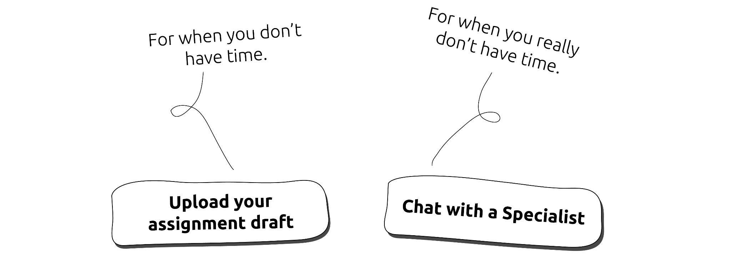
Check & improve your work, with fast, ethical feedback

Slide 3
Using Studiosity this semester
How you can use it to improve your work:
Upload your draft assignment for same-day response and feedback.
Connect instantly and chat live, to discuss or check your work in Biology, Chemistry, Physics, Maths and English.

