Slide 1
[Team name] Team Ways of Working
[Date]

Slide 2
Using this deck
This deck should support your team – make it your own. You do not need to use every slide (in fact, we encourage you to ‘start small’). You may decide to start with a few, move the rest to the ‘Ideas Garden’ and then return to it later or as the need arises. It might be helpful to start the development through a team workshop, or you could decide to do one item a time in your team meetings. How you choose to put your deck together is up to you and should support your team and its objectives.
Each slide has a title, as well as explanatory notes in italics. Once complete, you should identify how and when you might return to your Team Deck. Some teams add it as a pinned item at the top of a Teams channel, others put it as a standing item on a quarterly meeting, or put a ‘culture check in’ in the calendar for a future date.
Much of this deck is based off the Fearless Organisation Team Culture Canvas. This deck combines the elements from the Culture Canvas with some of the more pragmatic elements a new starter often wonders about. You may decide to remove some elements or add new ones in.
This deck is intended to support your team to: (1) clarify and document your ways of working (2) help new colleagues to understand the often unspoken/implicit norms of their new team to ease the transition process
Additional resources:
The Fearless Organisation culture canvas
Expert talk about the culture canvas tool
If you have questions or would like additional support, please contact: hrorgperf@adelaide.edu.au

Slide 3
Start here
Welcome to our team board! This is a living document. It evolves as we do.
You do not need permission to add to the team board.
If you see something missing, context that would be helpful, or question that should be answered - add it!
If there is a section you think is missing, [how do team members add information? for example: you can add it to the ideas garden in the bottom right hand corner, and add it to our Team Meeting agenda for the next month for us to discuss as a team.]
We hope it helps new team members understand our ways of working, and documents the ways we've decided as a team to work together to pursue our goals.

Slide 4
Who we are (people and roles)
[Team name]
Name - Role
Name - Role
Name - Role
Name – Role
Name – Role
Name – Role
Name – Role
[Your Name here] – [Your role here]
If you are also using the ‘About Me’ template to build an “Our People” deck, you might decide to link it here for new starters

Slide 5
Our purpose
Why do we exist?

Slide 6
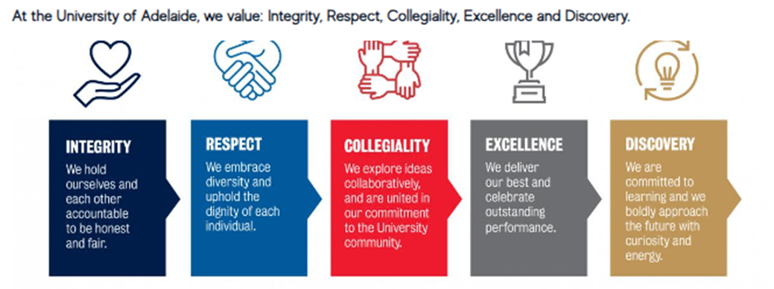
Values
How do the University values play out in our day to day? What behaviours do we reward or are taboo?

Slide 7
Decision-making
How do we share authority? What method do we use to make decisions?

Slide 8
Meetings
How do we convene and collaborate?

Slide 9
Norms & Rules
How do we clarify expected behaviours without hindering autonomy?

Slide 10
Rituals
What are our unique ways of starting, managing and celebrating projects?

Slide 11
Feedback
How do we help each other grow?

Slide 12
Psychological Safety
How do we encourage everyone to speak up? How do we promote participation and candour over group think and silence?

Slide 13
Communication
How do we communicate as a team (email, Teams, face-to-face?)

Slide 14
Collaboration
How do we collaborate as a team?

Slide 15
Recognition
How do we recognize one another?

Slide 16
Prioritization
How do we prioritize our work?

Slide 17
Where we store documents and information
Where do you store documents and information? Are there naming conventions or a filing logic that might be helpful to document?

Slide 18
Systems we use
Which systems does your team use? You may also want to link to any user guides or access information.

Slide 19
Hours and place of work
Does the team have a set of core hours? Do team members work from home or from the office (or both?) Are there members of the team who are part time? This can be a general statement, with specifics for individuals shared separately.

Slide 20
Ideas Garden
What topics have you not covered? What topics might you want to explore as a team in future? These could be documented in the ideas garden so they have an opportunity to be re-visited in future. You can either write them here, or add them as a new slide after this one.

